Slide 1
INSE Project Overview
Team ‘Master Race Condition’
Harry Owen
Omar Qassem
Paddy Trail
Todd Perry

Slide 2
The Project
We have been assigned to create a program that creates Gantt charts, PERT diagrams and Work Breakdown Trees from a single data input.

Slide 3
The Plan
We are going to use an approach based on the Waterfall Model
It uses a Linear, Top Down Approach
‘The more work done early on, means less work has to be done late in the project’
It’s a minimalistic and simple approach
We can allocate large amounts of time to design and code the project

Slide 4
Analysis
For the analysis we are first working out the functional and non-functional requirements
After this we will be looking into what the inputs and outputs will be and what will be on the printouts.
Once we have gathered this information, we will be assessing the main issues that we have to tackle.

Slide 5
Design
Along with the coding, design is one of the larger areas in the development; it includes:
Writing pseudocode and drafting algorithms
Designing the GUI
Technical drawing of the GUI
Proving the code and estimating its complexity
Writing a test plan
Drawing up a storyboard

Slide 6
Coding
Another large area of the project is the coding, which consists of:
Drawing up UML diagrams
Splitting the tasks between us (The coding itself)
Building the GUI
Modular Testing
Debugging

Slide 7
Testing
After coding is finished, the main testing commences, the different types of testing will include:
Input validation, and output checks
Integration testing
Crash testing
Does it meet the requirements?
Platform testing

Slide 8

Integration
The final stage of the project is the integration. Sub-tasks include:
Publishing the program
Writing a User Manual
Writing instructions for installation
Writing a readme file

Slide 9

Programming Language
As a group we have decided to use Java as our main language. This being because:
We are all fluent in both Java and Object Oriented Design
The NetBeans IDE supports GUI design and construction using an intuitive interface
Platform Independence

Slide 10

Cloud Resources
We will be using Github, as it is built specifically for use with the Git versioning software we will be using. Other advantages include:
Simple and effective collaboration
Designed with a developer-oriented perspective
Minimalistic approach to version control (No clutter or bloat)
It’s free

Slide 11
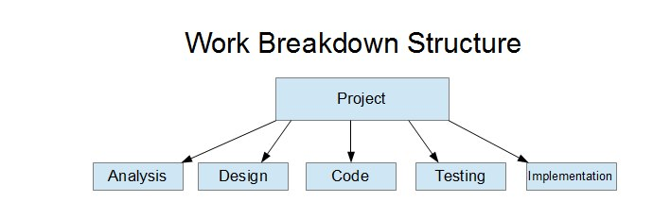
WBS

Slide 12
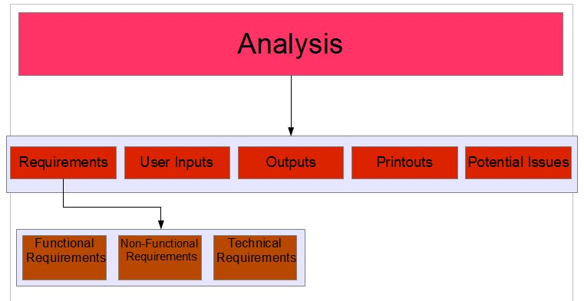
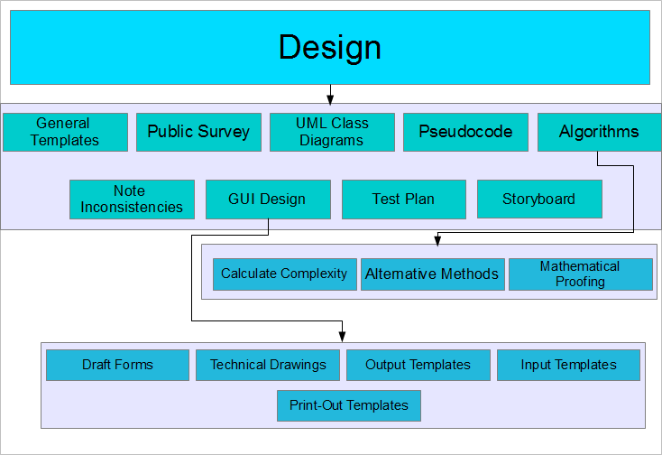
WBS

Slide 13
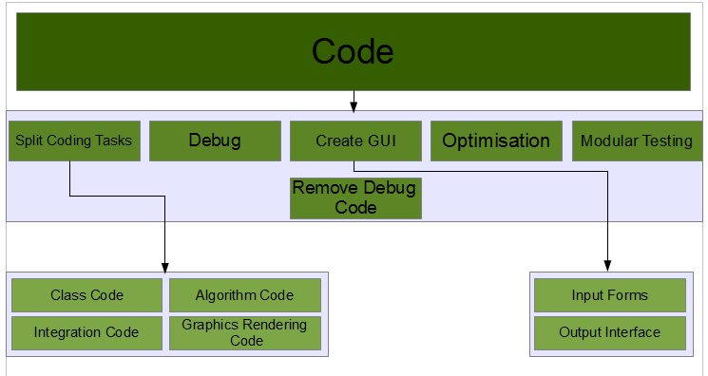
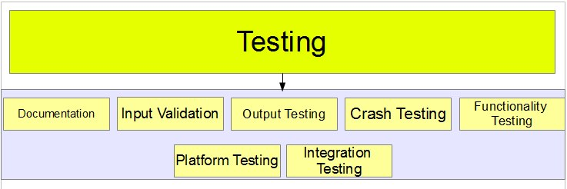
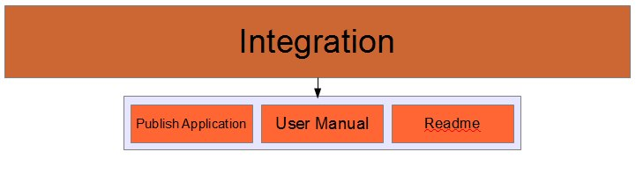
WBS

Slide 14
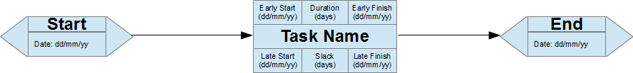
PERT

Slide 15
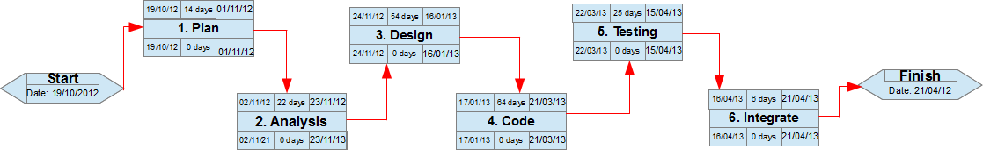
Project PERT

Slide 16
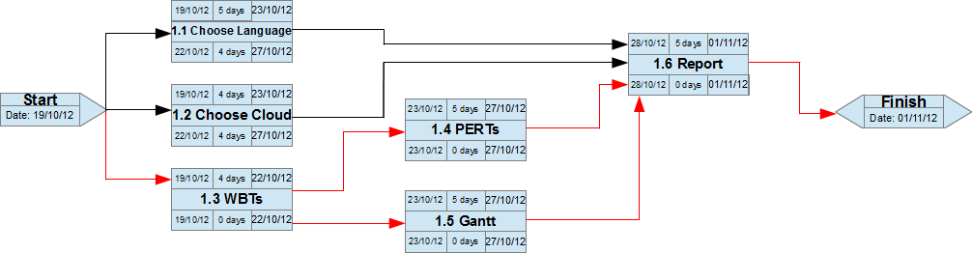
Planning PERT

Slide 17
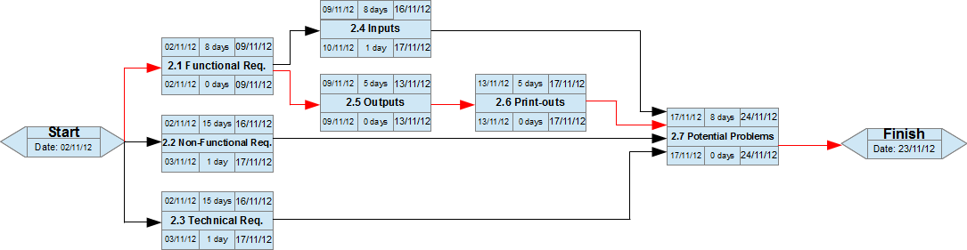
Analysis PERT

Slide 18
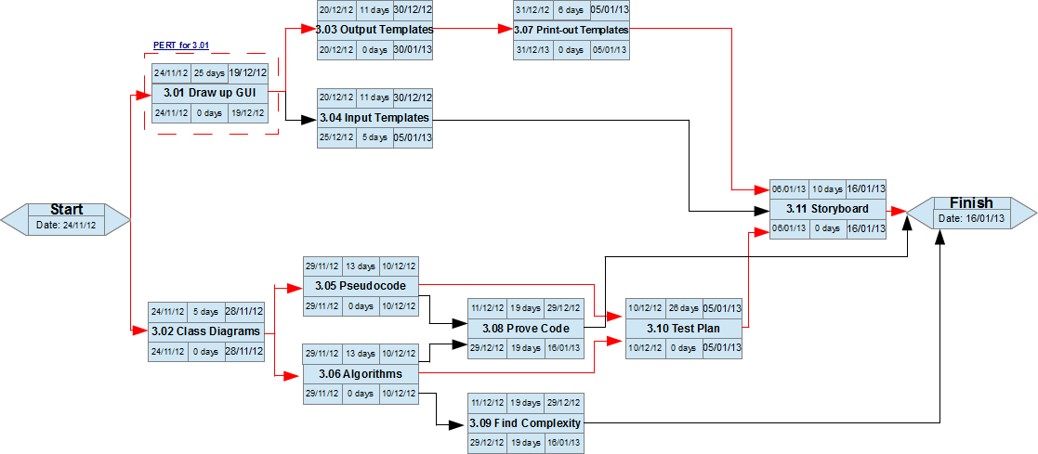
Design PERT

Slide 19
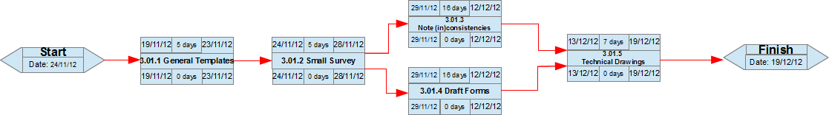
Design Task 3.01 PERT

Slide 20
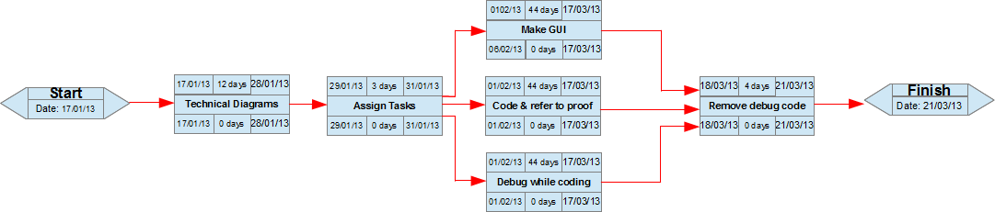
Coding PERT

Slide 21
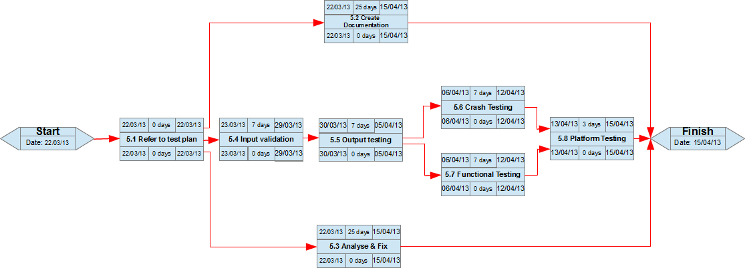
Testing PERT

Slide 22
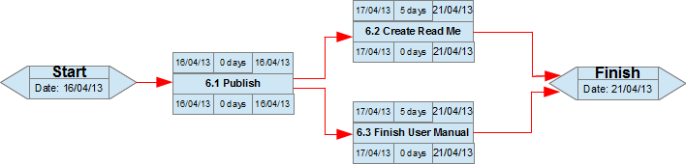
Integration PERT

Slide 23

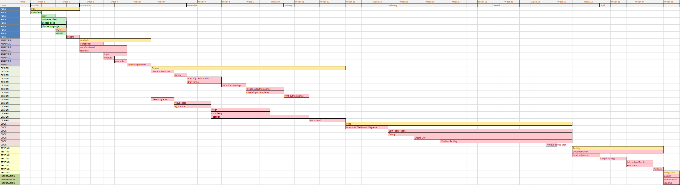
Gantt

Slide 24
FEEDBACK/Questions?

